Slide 1
Unit 4:Longest Common Subsequence
Dynamic Programming

Slide 2
Dynamic Programming
Works “bottom-up”
Finds solutions to small sub-problems first
Stores them
Combines them somehow to find a solution to a slightly larger subproblem
Compare to greedy approach
Also requires optimal substructure
But greedy makes choice first, then solves

Slide 3
General Strategy of Dyn. Prog.
Structure: What’s the structure of an optimal solution in terms of solutions to its subproblems?
Give a recursive definition of an optimal solution in terms of optimal solutions to smaller problems
Usually using min or max
Use a data structure (often a table) to store smaller solutions in a bottom-up fashion
Optimal value found in the table
(If needed) Reconstruct the optimal solution
I.e. what produced the optimal value

Slide 4
Longest Common Subsequence (LCS)
Application: comparison of two DNA strings
Ex: X= {A B C B D A B }, Y= {B D C A B A}
Longest Common Subsequence:
X = A B C B D A B
Y = B D C A B A
Brute force algorithm would compare each subsequence of X with the symbols in Y

Slide 5
LCS Algorithm
if |X| = m, |Y| = n, then there are 2^{m} subsequences of X; we must compare each with Y (n comparisons)
So the running time of the brute-force algorithm is O(n 2^{m})
Notice that the LCS problem has optimal substructure: solutions of subproblems are parts of the final solution.
Subproblems: “find LCS of pairs of prefixes of X and Y”
Notes:
Illustration:
From previous slide:
X = A B C B D A B
Y = B D C A B A
X_3, a prefix of X: ABC
Y_4, a prefix of Y: BDCA
Optimal solution for these is: BC

Slide 6
LCS Algorithm
First we’ll find the length of LCS. Later we’ll modify the algorithm to find LCS itself.
Define X_{i}, Y_{j} to be the prefixes of X and Y of length i and j respectively
Define c[i,j] to be the length of LCS of X_{i} and Y_{j}
Then the length of LCS of X and Y will be c[m,n]

Slide 7
LCS recursive solution
We start with i = j = 0 (empty substrings of x and y)
Since X₀ and Y₀ are empty strings, their LCS is always empty (i.e. c[0,0] = 0)
LCS of empty string and any other string is empty, so for every i and j: c[0, j] = c[i,0] = 0

Slide 8
LCS recursive solution
When we calculate c[i,j], we consider two cases:
First case: x[i]=y[j]: one more symbol in strings X and Y matches, so the length of LCS X_{i} and Y_{j} equals to the length of LCS of smaller strings X_{i-1} and Y_{i-1} , plus 1

Slide 9
LCS recursive solution
Second case: x[i] != y[j]
As symbols don’t match, our solution is not improved, and the length of LCS(X_{i} , Y_{j}) is the same as before (i.e. maximum of LCS(X_{i}, Y_{j-1}) and LCS(X_{i-1},Y_{j})
Why not just take the length of LCS(X_{i-1}, Y_{j-1}) ?

Slide 10
LCS Length Algorithm
LCS-Length(X, Y)
1. m = length(X) // get the # of symbols in X
2. n = length(Y) // get the # of symbols in Y
3. for i = 1 to m c[i,0] = 0 // special case: Y₀
4. for j = 1 to n c[0,j] = 0 // special case: X₀
5. for i = 1 to m // for all X_{i}
6. for j = 1 to n // for all Y_{j}
7. if ( X_{i} == Y_{j} )
8. c[i,j] = c[i-1,j-1] + 1
9. else c[i,j] = max( c[i-1,j], c[i,j-1] )
10. return c[m,n] // return LCS length for X and Y

Slide 11
LCS Example
We’ll see how LCS algorithm works on the following example:
X = ABCB
Y = BDCAB
What is the Longest Common Subsequence
of X and Y?
LCS(X, Y) = BCB
X = A B C B
Y = B D C A B

Slide 12
LCS Example (0)
ABCB
BDCAB
j 0 1 2 3 4 5
i
Yj
B
D
C
A
B
0
Xi
A
1
2
B
3
C
4
B
X = ABCB; m = |X| = 4
Y = BDCAB; n = |Y| = 5
Allocate array c[5,4]

Slide 13
LCS Example (1)
ABCB
BDCAB
j 0 1 2 3 4 5
i
Yj
B
D
C
A
B
0
Xi
0
0
0
0
0
0
A
1
0
2
B
0
3
C
0
4
B
0
for i = 1 to m c[i,0] = 0
for j = 1 to n c[0,j] = 0

Slide 14
LCS Example (2)
ABCB
BDCAB
j 0 1 2 3 4 5
i
Yj
B
D
C
A
B
0
Xi
0
0
0
0
0
0
A
1
0
0
2
B
0
3
C
0
4
B
0
if ( X_{i} == Y_{j} )
c[i,j] = c[i-1,j-1] + 1
else c[i,j] = max( c[i-1,j], c[i,j-1] )

Slide 15
LCS Example (3)
ABCB
BDCAB
j 0 1 2 3 4 5
i
Yj
B
D
C
A
B
0
Xi
0
0
0
0
0
0
A
1
0
0
0
0
2
B
0
3
C
0
4
B
0
if ( X_{i} == Y_{j} )
c[i,j] = c[i-1,j-1] + 1
else c[i,j] = max( c[i-1,j], c[i,j-1] )

Slide 16
LCS Example (4)
ABCB
BDCAB
j 0 1 2 3 4 5
i
Yj
B
D
C
A
B
0
Xi
0
0
0
0
0
0
A
1
0
0
0
0
1
2
B
0
3
C
0
4
B
0
if ( X_{i} == Y_{j} )
c[i,j] = c[i-1,j-1] + 1
else c[i,j] = max( c[i-1,j], c[i,j-1] )

Slide 17
LCS Example (5)
ABCB
BDCAB
j 0 1 2 3 4 5
i
Yj
B
D
C
A
B
0
Xi
0
0
0
0
0
0
A
1
0
0
0
0
1
1
2
B
0
3
C
0
4
B
0
if ( X_{i} == Y_{j} )
c[i,j] = c[i-1,j-1] + 1
else c[i,j] = max( c[i-1,j], c[i,j-1] )

Slide 18
LCS Example (6)
ABCB
BDCAB
j 0 1 2 3 4 5
i
Yj
B
D
C
A
B
0
Xi
0
0
0
0
0
0
A
1
0
0
0
0
1
1
2
B
0
1
3
C
0
4
B
0
if ( X_{i} == Y_{j} )
c[i,j] = c[i-1,j-1] + 1
else c[i,j] = max( c[i-1,j], c[i,j-1] )

Slide 19
LCS Example (7)
ABCB
BDCAB
j 0 1 2 3 4 5
i
Yj
B
D
C
A
B
0
Xi
0
0
0
0
0
0
A
1
0
0
0
0
1
1
2
B
0
1
1
1
1
3
C
0
4
B
0
if ( X_{i} == Y_{j} )
c[i,j] = c[i-1,j-1] + 1
else c[i,j] = max( c[i-1,j], c[i,j-1] )

Slide 20
LCS Example (8)
ABCB
BDCAB
j 0 1 2 3 4 5
i
Yj
B
D
C
A
B
0
Xi
0
0
0
0
0
0
A
1
0
0
0
0
1
1
2
B
0
1
1
1
1
2
3
C
0
4
B
0
if ( X_{i} == Y_{j} )
c[i,j] = c[i-1,j-1] + 1
else c[i,j] = max( c[i-1,j], c[i,j-1] )

Slide 21
LCS Example (10)
ABCB
BDCAB
j 0 1 2 3 4 5
i
Yj
B
D
C
A
B
0
Xi
0
0
0
0
0
0
A
1
0
0
0
0
1
1
2
B
0
1
1
1
1
2
3
C
0
1
1
4
B
0
if ( X_{i} == Y_{j} )
c[i,j] = c[i-1,j-1] + 1
else c[i,j] = max( c[i-1,j], c[i,j-1] )

Slide 22
LCS Example (11)
ABCB
BDCAB
j 0 1 2 3 4 5
i
Yj
B
D
C
A
B
0
Xi
0
0
0
0
0
0
A
1
0
0
0
0
1
1
2
B
0
1
1
1
1
2
3
C
0
1
1
2
4
B
0
if ( X_{i} == Y_{j} )
c[i,j] = c[i-1,j-1] + 1
else c[i,j] = max( c[i-1,j], c[i,j-1] )

Slide 23
LCS Example (12)
ABCB
BDCAB
j 0 1 2 3 4 5
i
Yj
B
D
C
A
B
0
Xi
0
0
0
0
0
0
A
1
0
0
0
0
1
1
2
B
0
1
1
1
1
2
3
C
0
1
1
2
2
2
4
B
0
if ( X_{i} == Y_{j} )
c[i,j] = c[i-1,j-1] + 1
else c[i,j] = max( c[i-1,j], c[i,j-1] )

Slide 24
LCS Example (13)
ABCB
BDCAB
j 0 1 2 3 4 5
i
Yj
B
D
C
A
B
0
Xi
0
0
0
0
0
0
A
1
0
0
0
0
1
1
2
B
0
1
1
1
1
2
3
C
0
1
1
2
2
2
4
B
0
1
if ( X_{i} == Y_{j} )
c[i,j] = c[i-1,j-1] + 1
else c[i,j] = max( c[i-1,j], c[i,j-1] )

Slide 25
LCS Example (14)
ABCB
BDCAB
j 0 1 2 3 4 5
i
Yj
B
D
C
A
B
0
Xi
0
0
0
0
0
0
A
1
0
0
0
0
1
1
2
B
0
1
1
1
1
2
3
C
0
1
1
2
2
2
4
B
0
1
1
2
2
if ( X_{i} == Y_{j} )
c[i,j] = c[i-1,j-1] + 1
else c[i,j] = max( c[i-1,j], c[i,j-1] )

Slide 26
LCS Example (15)
ABCB
BDCAB
j 0 1 2 3 4 5
i
Yj
B
D
C
A
B
0
Xi
0
0
0
0
0
0
A
1
0
0
0
0
1
1
2
B
0
1
1
1
1
2
3
C
0
1
1
2
2
2
4
B
3
0
1
1
2
2
if ( X_{i} == Y_{j} )
c[i,j] = c[i-1,j-1] + 1
else c[i,j] = max( c[i-1,j], c[i,j-1] )

Slide 27
LCS Algorithm Running Time
LCS algorithm calculates the values of each entry of the array c[m,n]
So what is the running time?
O(m*n)
since each c[i,j] is calculated in constant time, and there are m*n elements in the array

Slide 28
How to find actual LCS
So far, we have just found the length of LCS, but not LCS itself.
We want to modify this algorithm to make it output Longest Common Subsequence of X and Y
Each c[i,j] depends on c[i-1,j] and c[i,j-1]
or c[i-1, j-1]
For each c[i,j] we can say how it was acquired:
For example, here
c[i,j] = c[i-1,j-1] +1 = 2+1=3
2
2
2
3

Slide 29
How to find actual LCS - continued
Remember that
So we can start from c[m,n] and go backwards
Look first to see if 2nd case above was true
If not, then c[i,j] = c[i-1, j-1]+1, so remember x[i] (because x[i] is a part of LCS)
When i=0 or j=0 (i.e. we reached the beginning), output remembered letters in reverse order

Slide 30
Finding LCS
j 0 1 2 3 4 5
i
Yj
B
D
C
A
B
0
Xi
0
0
0
0
0
0
A
1
0
0
0
0
1
1
2
B
0
1
1
1
1
2
3
C
0
1
1
2
2
2
4
B
3
0
1
1
2
2

Slide 31
Finding LCS (2)
j 0 1 2 3 4 5
i
Yj
B
D
C
A
B
0
Xi
0
0
0
0
0
0
A
1
0
0
0
0
1
1
2
B
0
1
1
1
1
2
3
C
0
1
1
2
2
2
4
B
3
0
1
1
2
2
LCS (reversed order):
B
C
B
B C B
(this string turned out to be a palindrome)
LCS (straight order):

Slide 32
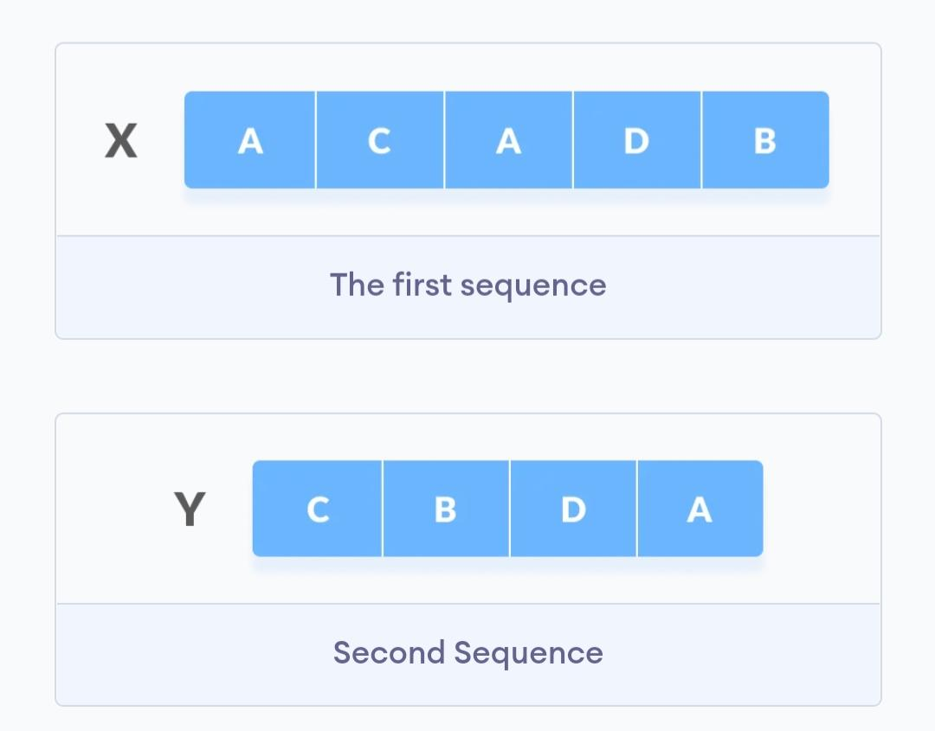
Example

Slide 33
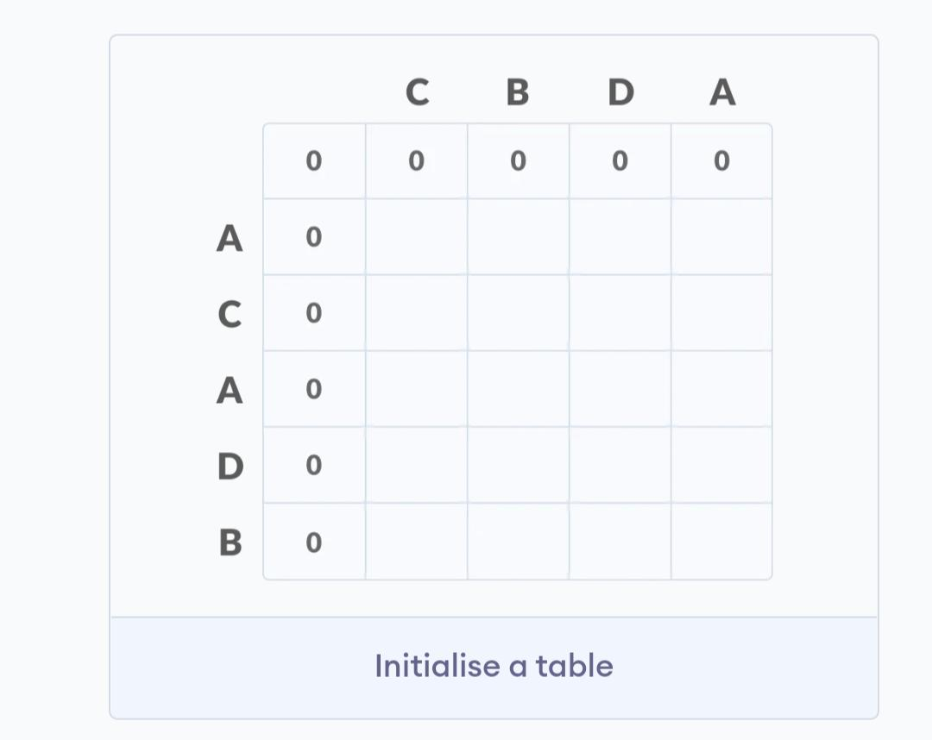

Slide 34
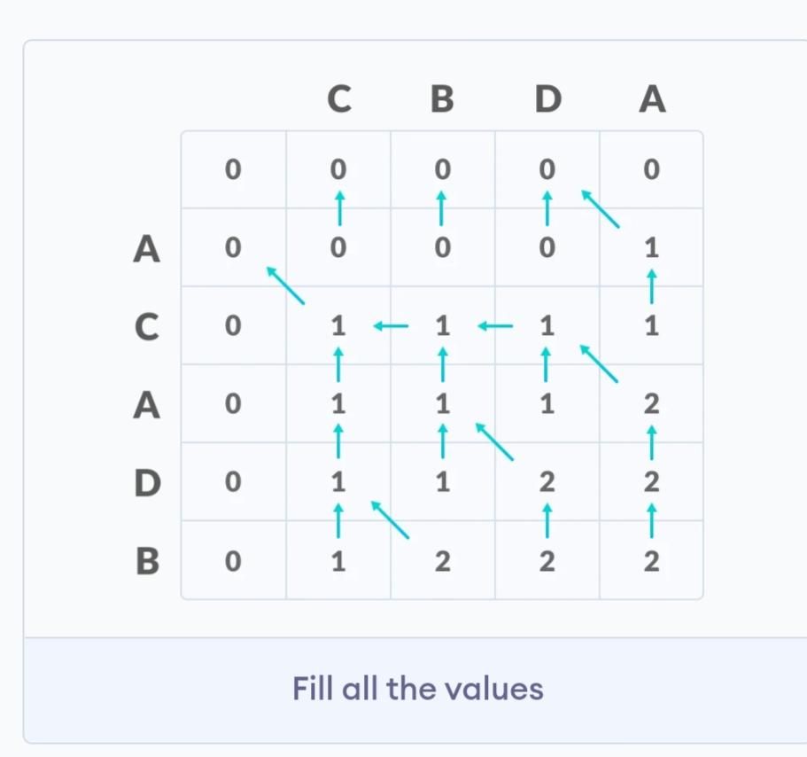

Slide 35
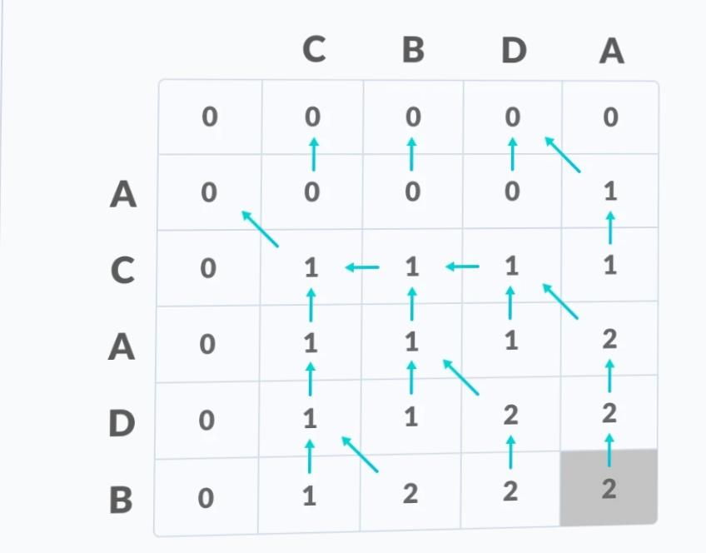

Slide 36
